Slide 1
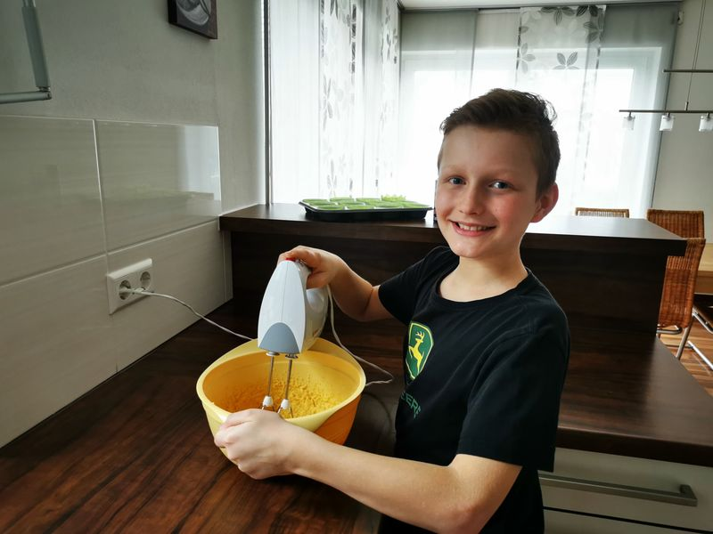
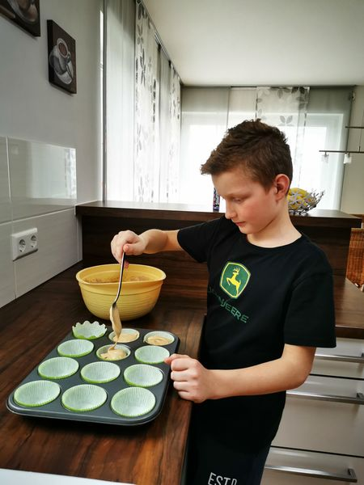
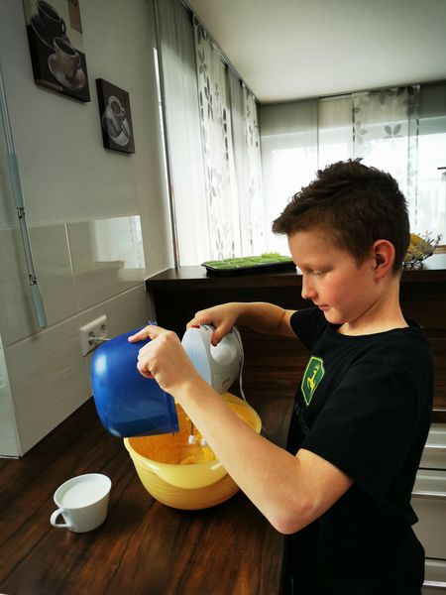
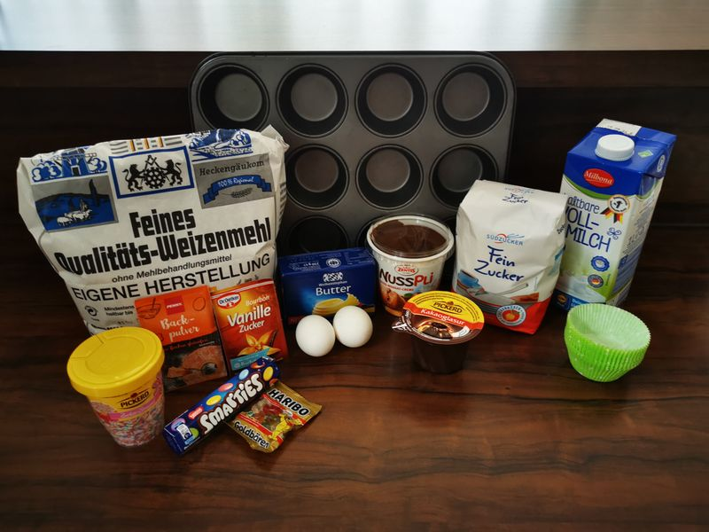
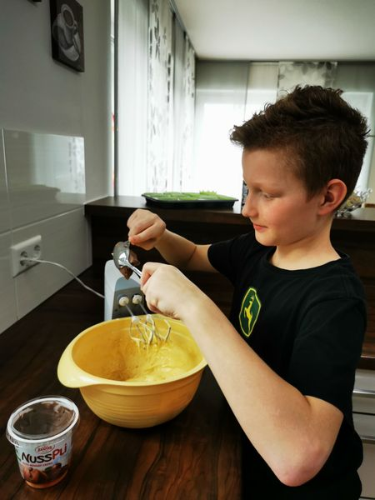
Muffins recipe
Ingredients:
a half packet of butter
125g sugar
a packet of vanilla sugar
2 eggs
200g flour
a half packet of baking powder
a cup of milk
2 spoons of nut nougat cream
choclate glaze
some sweets for decoration

